Slide 1
GROUP MONTE CARLO DATA EXPLORATION REPORT Predicting USD IRS 3Y Rates with Linear Regression
Huseyin Albay
Furkan Demirbas
Betul Demirkol
Ugurcan Ocak

Slide 2
WHAT IS THE INTUITION BEHIND THE SUBJECT?
The main idea behind the IRS is to hedge from future fluctuations.
By receiving fix and paying floating rates, a party can make a profit in a dovish environment but can also have loss under the hawkish rates.
Depending on the how big the position is, a position may create enormous marked-to-market daily profit or loss.

Slide 3
In this study, probability of change in the 3Y IRS rates will be calculated by Monte Carlo Simulation, assuming the daily changes for the 253 days are normally distributed.
And we will hypothetically predict a daily loss expectation trend from 2015 to today by using regression
Finally, actual data between 2015 to 2019 will be studied to see the validity of the trend analysis.

Slide 4
The main goal we seek is does
our study of probability of loss is favorable for short or long USD 3Y IRS positions?

Slide 5
DATA SOURCE
Since 01/01/2010, USD IRS 3Y fix rates values are available on Reuters.
By Excel add-in of the Reuters, we can import the daily data from Reuters Eikon Terminal up until today.
The data between 2010 and 2015 will be used to create predictions by ML
The data between 2015 and 2019 will be used to test the validity of the model.

Slide 6
SOME FEATURES OF THE DATA
num_1015: Number of data available for 2015-2019 period. Data of 1305 days are available
num_return_1015: Number of the mean of the daily returns, since the Basel Committee advices to use the data of the last 253 days, we have 1053 daily returns.
num_return_1519: The number of the returns between 2015-2019 period.

Slide 7
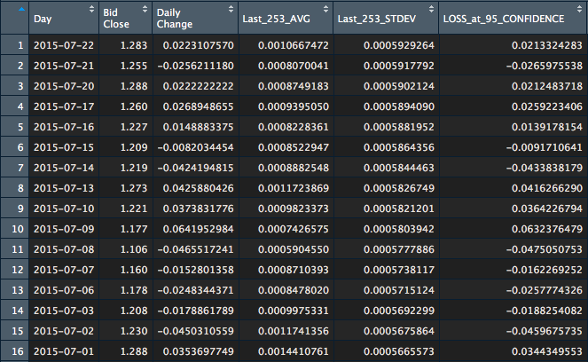

Slide 8
ML METHODS TO BE EMPLOYED
In the green circle, there are the data to be used for linear regression
In the orange cirlce, there are the data to be used to test linear regression

Slide 9
By using previous 1305 values between 2010-2015
the data of the every next 253 days will be predicted.
2010-2015 will be used to predict 2016
2011-2016 will be used to predict 2017
2012-2017 will be used to predict 2018
2013-2018 will be used to predict 2019
Also, from the daily changes of the closing values, we will analyze the trend in VaR.

